Slide 1
React Router

Slide 2
FYIs
Today we will be going over Router 2, React Router 4 is already out but the fundamentals are all the same
INCEPTION
Your package.json likely already has Router 2 if you’ve been using the package.json files from the curriculum :)
https://github.com/reactjs/react-router-tutorial/tree/master/lessons

Slide 3
What is React Router?
React Router is a library based on top of the React library
Helps in easy and quick routing of a react application with multiple ages
Can be done without router, but as application grows and parent-child relationships become more unwieldy React-router helps us identify how to build the nested UIs

Slide 4
React Router
Still in React realm, React Router is just a component (a really dope component)
We will wrap everything in a new top level component called Root that wraps everything we’re utilizing from router

Slide 5
Why use React Router?
Declarative - can load components based on URL
Gives you links to other parts of your react app
Allows you to nest routes
Take advantage of using js to manipulate URL without making http request, keep track of browsing history
Dynamic routing ftw

Slide 6
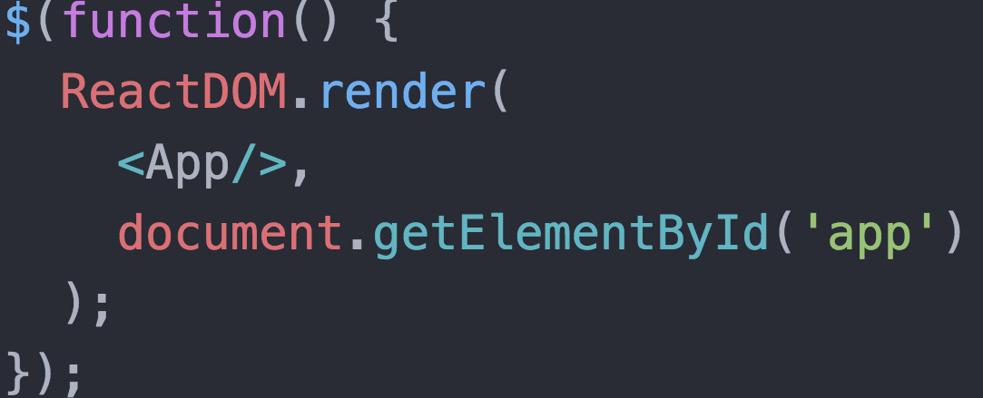
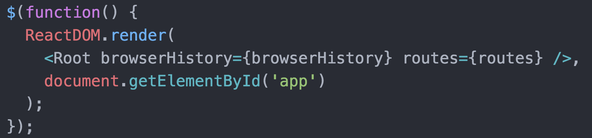
Main.js
Before
After
BrowserHistory comes with the library, let’s take a closer look at routes

Slide 7

Declarative Routing

Slide 8
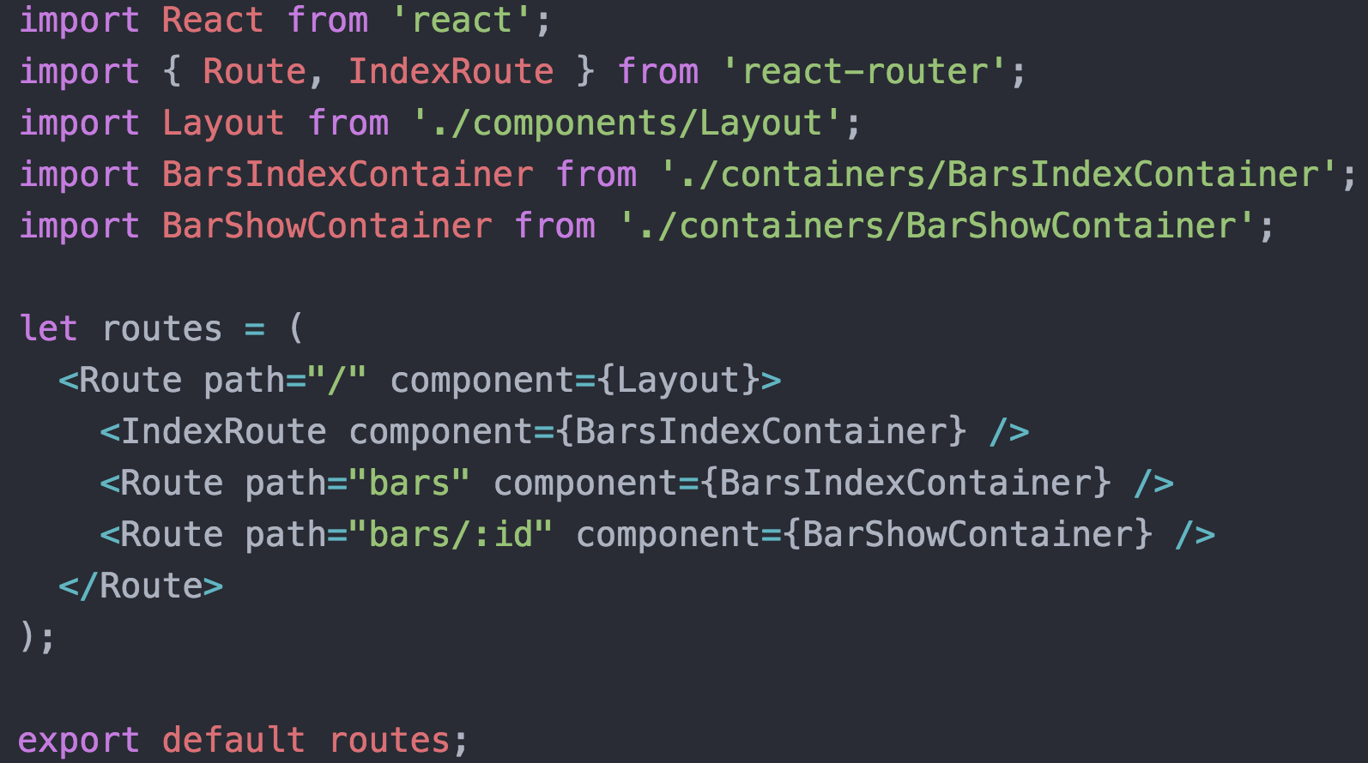
Routes.js

Slide 9
Routes.js
Notice how Routes are just components, the props it takes in is the component you want associated with that route

Slide 10
Routes.js - Top Level Route
Any components you pass into your top level Route will be rendered on every page of your App
Perfect for anything you want on every page, such as a nav bar, header, footer, sidebar

Slide 11
Routes.js - Nested Routes
What happens when the url goes to host/bars/5?
This dynamic routing should look familiar, similar to uri pattern in rake routes and sinatra
The highlighted route is triggered, it is nested within our top level route and there is a “child” of that “parent” component - how?

Slide 12
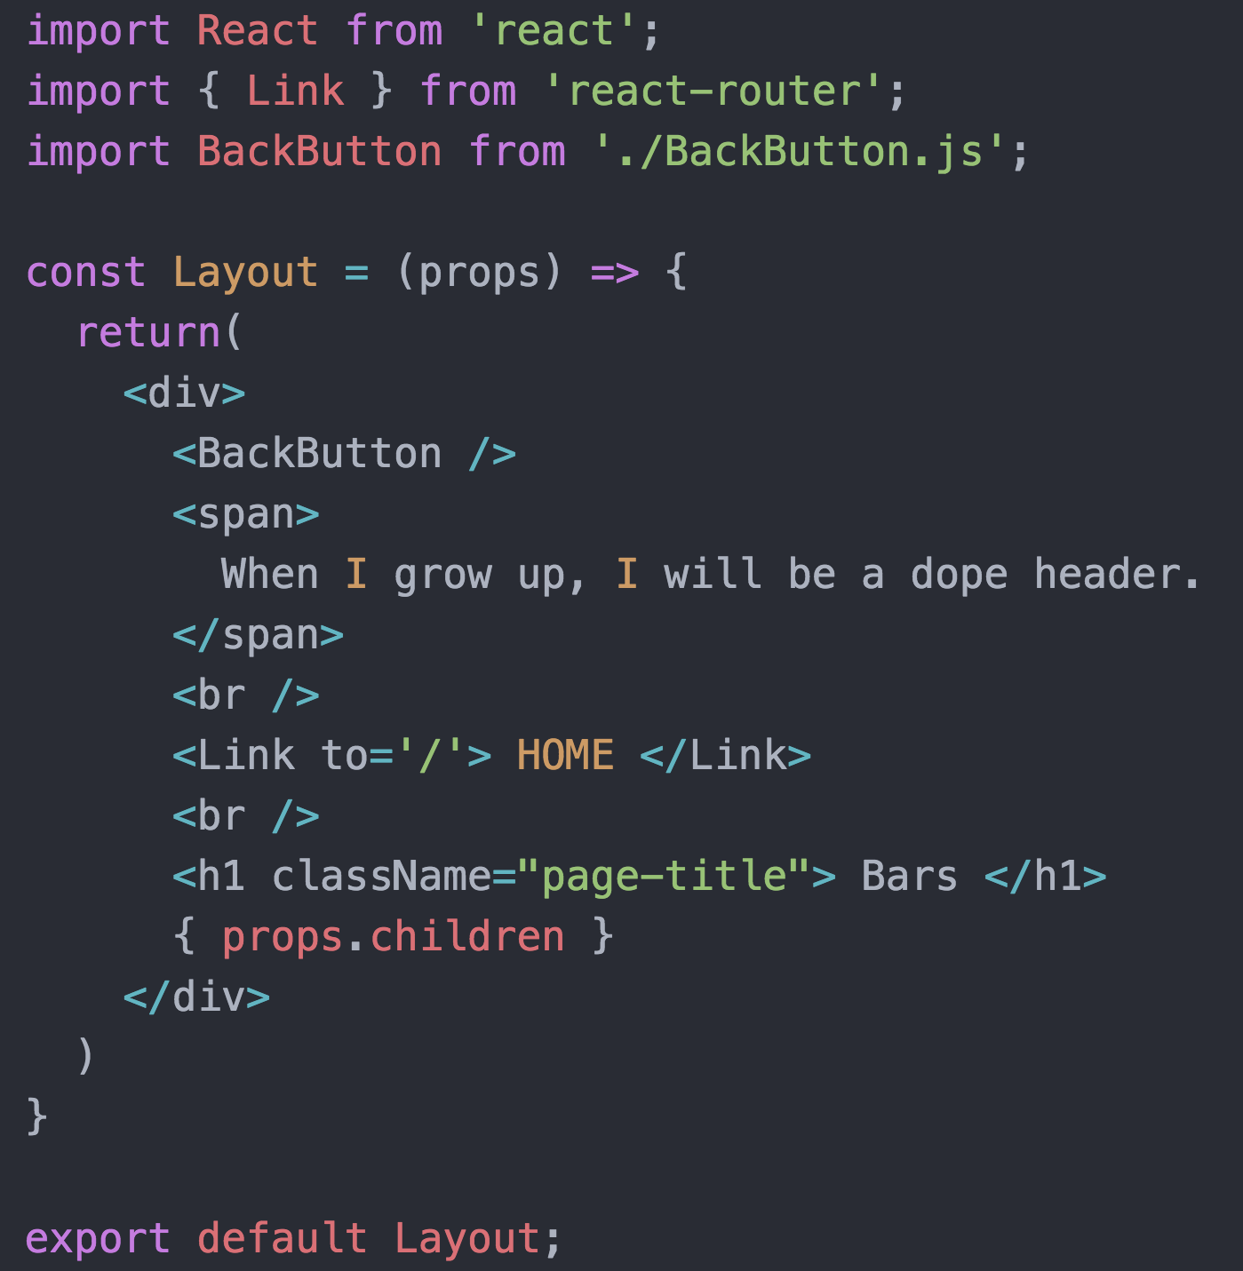
Layout.js - nested routes
For any parent component with child components, use ` { props.children } ` - this will render any of its children if the URI matches the route
So when we go to /bars/5, the BarShowContainer will be rendered here (similar to yield in layout from erb)
If we’re only at “/”, no children will be rendered

Slide 13
IndexRoute
For whatever level of nesting you’ve declared an IndexRoute, if no other route matches it becomes the default child of the parent
For example if you went to “/”, none of its nested routes match that uri pattern, so Layout will render, and where Layout has props.children, “bars index container” will be rendered there
ie if you go to “/bars/3”, bars index container will not be rendered

Slide 14
Link to - navigation
React Router Library comes with Link
Nearly identical to <a/> tag but it knows the router it was rendered in, and will take you to that part of your react app rather than making a new http request
Can dynamically create links similar to rails, ie

Slide 15
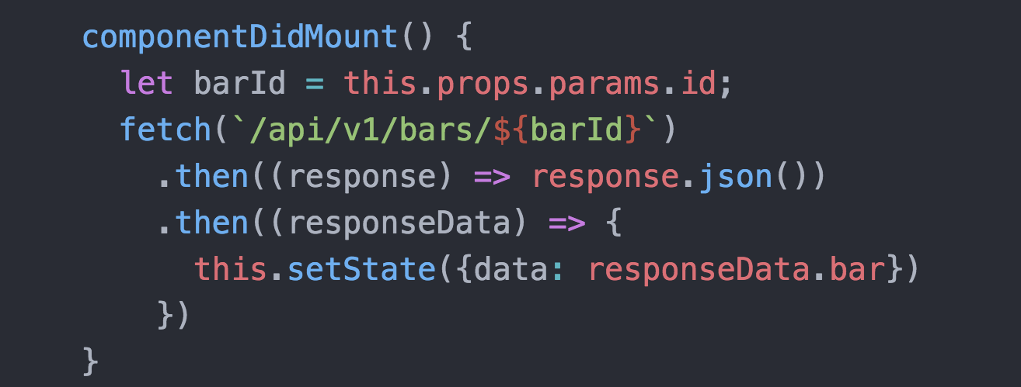
Params
Can now grab params from the url, it is passed to a component via its props, access is parallel to rails / sinatra
BarShowContainer
Grab params via props.paraps.nameOfKeyInRoute
If url is /bars/5, this.props.params.id will be 5

Slide 16
Browser History
modern browsers let JS manipulate the URL without making an actual http request
browserHistory will keep track of your browsing history and is passed into your top-level root component as props so it will be available
Can do cool stuff like a back button so you can navigate, check out your question queue :)

Slide 17
Server Configuration
If you navigate to a nested route while in your React app, what happens if you click refresh? Or similarly if you type out “/bars/5” in your URL?
This causes an actual HTTP request, so you might run into “No Route Matches GET ‘bars/5’

Slide 18

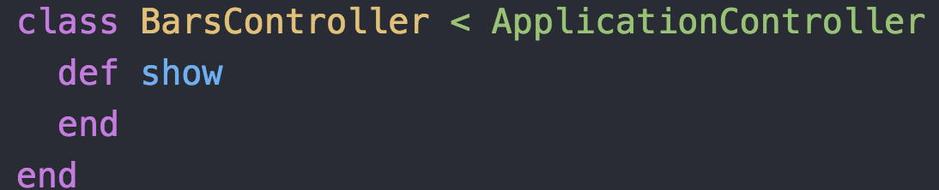
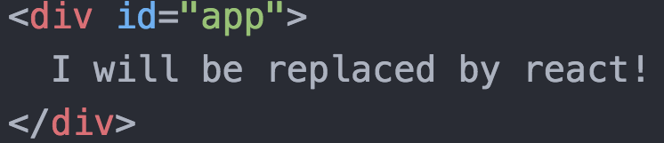
Server Configuration cont’d
routes.rb
Have to have matching rails routes so you can enter the react app at any point
These might just be empty and do pretty much nothing, but avoids the server from yelling at you
bars_controlleroutes.rb
bars/show.html.erb

Slide 19
Server Configuration example

Slide 20
DOPE

